Slide 1
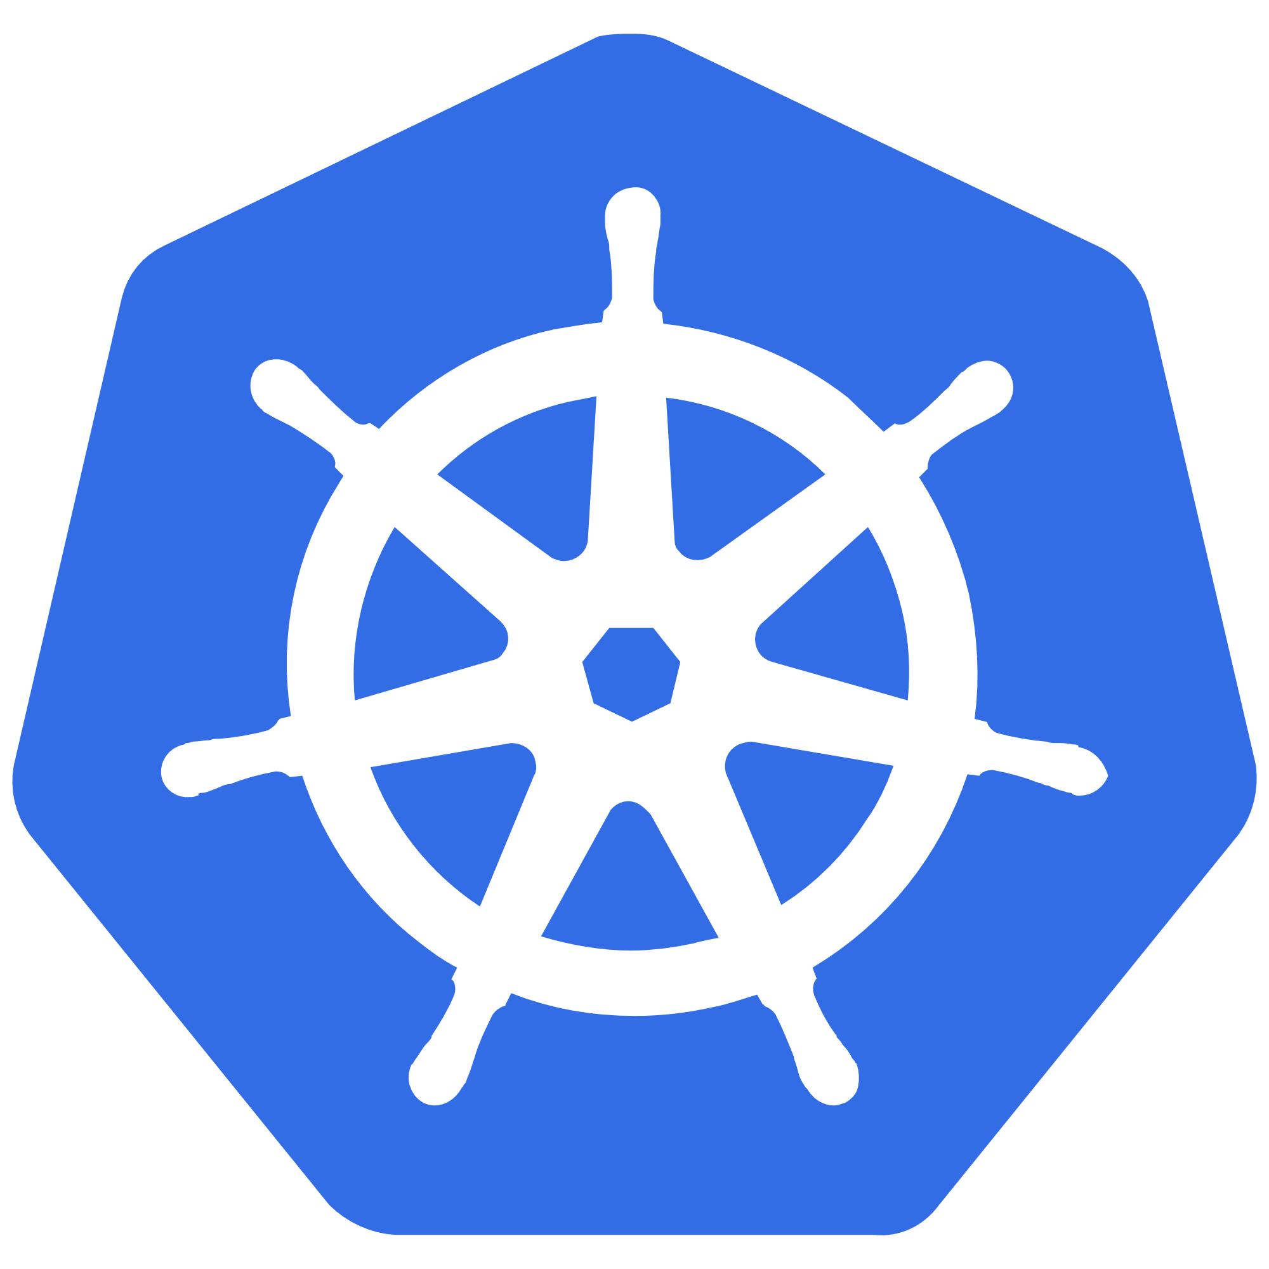
Kubernetes Technical Primer
Ben Coleman
@BenCodeGeek
Jan 2022, v1.6

Slide 2


Content Notes
This guide is not intended to be delivered as a complete presentation!
It can used as a learning guide or given as a reference
Cherry pick sections or slides and use/present as needed
Target Audience
Technical architects, developers and platform engineers
Those wanting to the learn the core fundamentals of Kubernetes
Not for those trying to deploy Kubernetes from scratch or get into internals

Slide 3
Introduction To Kubernetes
What is Cloud Native?
The need for orchestration
Kubernetes: the industry leading orchestrator
The elements of orchestration
Why Choose Kubernetes?
Kubernetes – A Modern Orchestrator
Core Concepts and Terms
Simplified Architecture
Internal Architecture
Highly Extensible
Core Components
Pods
Deployments & Replica Sets
Services
Services – Simplified Illustration
DNS and Service Discovery
Data Volumes & Mounts
Persistent Volumes
Stateful Sets
Daemon Sets
Jobs & CronJobs
Namespaces
Role Based Access Control (RBAC)
Putting It All Together
Using Kubernetes
Command Line - kubectl
Kubectl – Common Commands
Dashboard
Kubernetes Object Management
Introduction to the Declarative Model
Idempotent Updates & Desired State
Labels & Selectors
Configuring Basic Workloads
Environmental Variables
Secrets
ConfigMaps
Resource Management
Liveness & Readiness Probes
Commands & Arguments
Beyond The Basics
Service Mesh
Kubernetes Ecosystem – Common Projects
The Kubernetes API
Additional Network Services
Ingress
External DNS
Cert Manager
Putting It All Together
Debugging and Troubleshooting Workloads
Describing Objects
Container Logs
Get Shell Access
Advanced Pod Configuration
Deeper Dive on Manifests
Init Containers
Node Selector
Affinity and Taints
Sidecars
Scaling
Manually Scaling
Horizontal Pod Autoscaler (HPA)
Cluster Autoscaler (CA)
Extending Kubernetes
Custom Resource Definitions Operators
DevOps
Modern Infrastructure
Common DevOps Containers LifecycleCluster
GitOps
Isolation Patterns: Physical Isolation
Cluster Isolation Patterns: Logical Isolation
Helm Introduction
Helm – The Basics
Azure Kubernetes Service
Managed Kubernetes on Azure – AKS
AKS Networking Models
AKS Advanced Networking
Azure Active Directory
‘HTTP application routing’ Add-On
‘Monitoring’ Add-On
Dapr
AKS Virtual Nodes
Cluster Auto Scaler
Additional Resources
TABLE OF CONTENTS

Slide 4
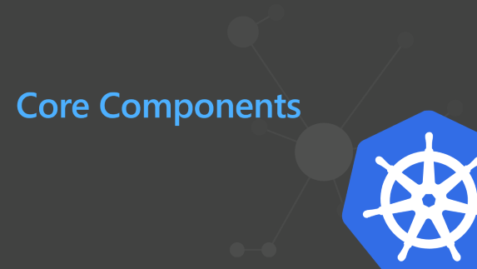
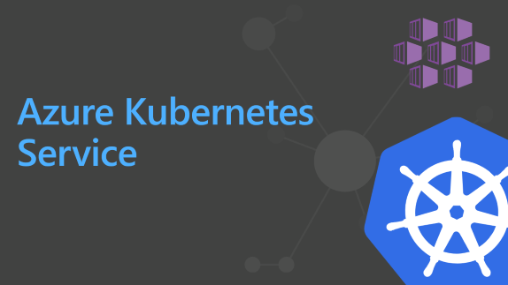
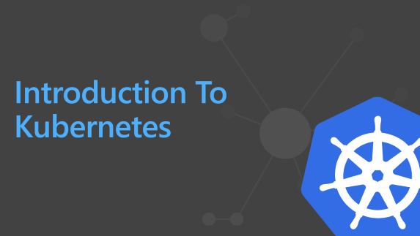
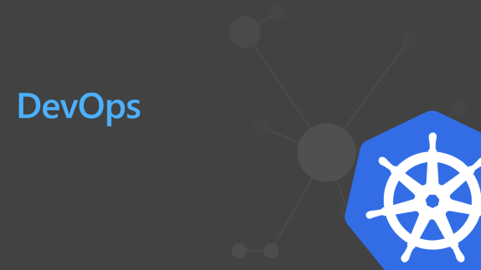
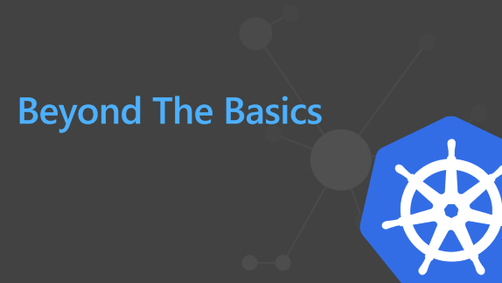
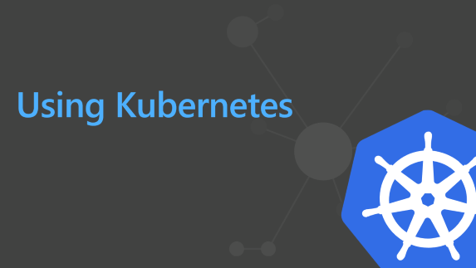
MAIN SECTIONS

Slide 5
Introduction To Kubernetes

Slide 6

What is Cloud Native?
“Cloud native technologies empower organizations to build and run scalable applications in modern, dynamic environments such as public, private, and hybrid clouds. Containers, service meshes, microservices, immutable infrastructure, and declarative APIs exemplify this approach.
These techniques enable loosely coupled systems that are resilient, manageable, and observable. Combined with robust automation, they allow engineers to make high-impact changes frequently and predictably with minimal toil.”

Slide 7
The need for orchestration
OK great,
But now what?
$ docker run myapp $ docker ps

Slide 8
The need for orchestration
NAME RESOLUTION
MANAGING PLACEMENT
RESOURCE MANAGEMENT
SECRETS
NETWORKING & LOAD BALANCING
SCHEDULING
SECURITY
SCALING UP/DOWN
HEALTH CHECKS
SERVICE DISCOVERY
FAILOVER
Production And At Scale

Slide 9
Kubernetes - production grade orchestration
Portable
Public, private, hybrid, multi-cloud
Extensible
Modular, pluggable, hookable, composable
Self-healing
Auto-placement, auto-restart, auto-replication, auto-scaling

Slide 10
The elements of orchestration
Scheduling
Affinity/anti-affinity
Health monitoring
Failover
Scaling
Networking
Service discovery
Coordinated app upgrades

Slide 11




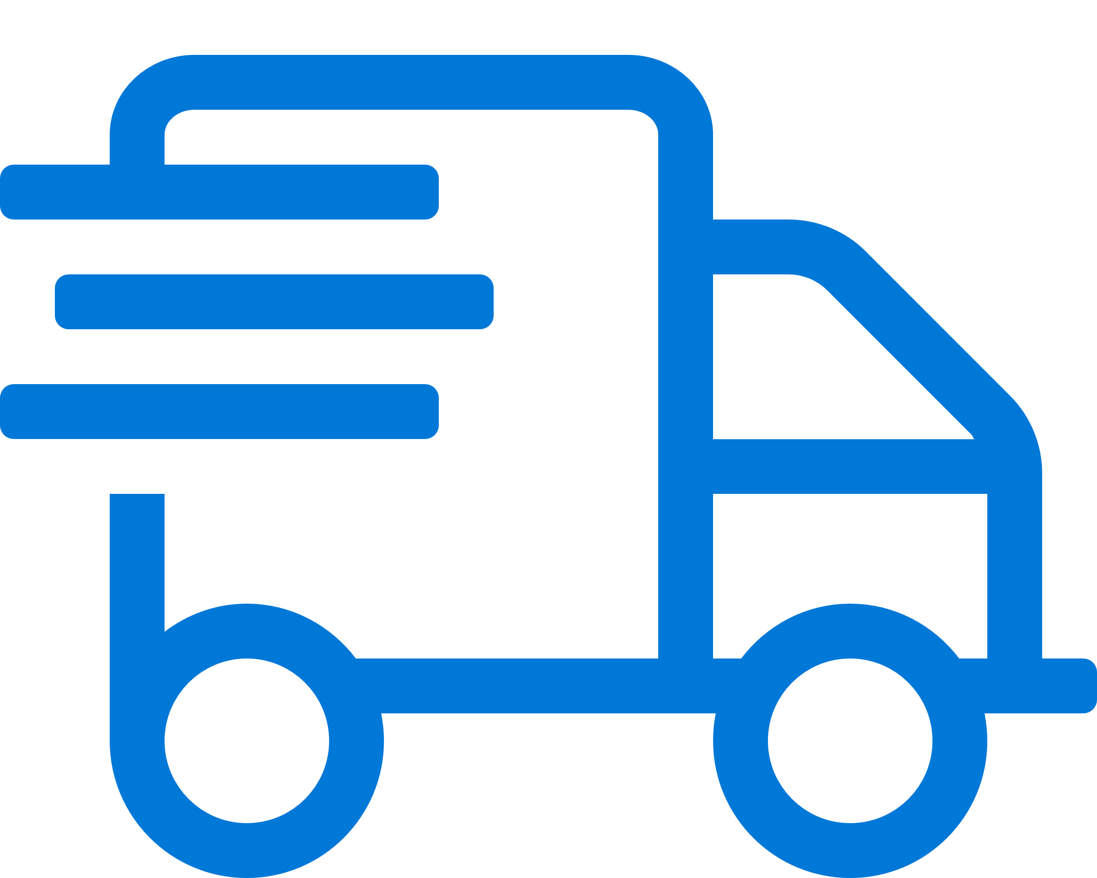


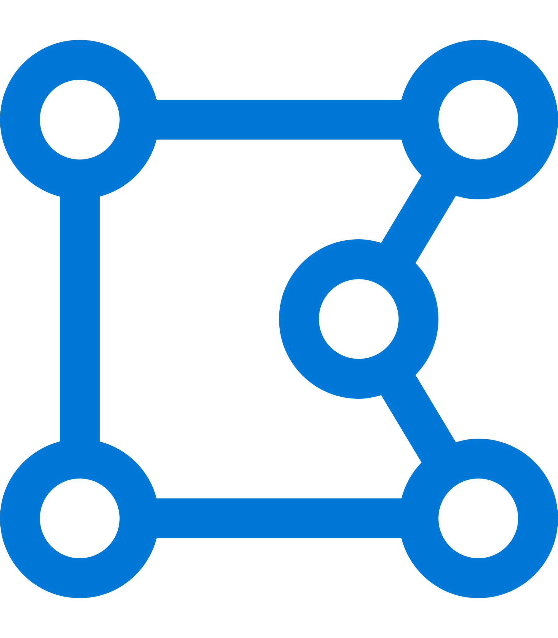
Why Choose Kubernetes?
Cornerstone of cloud native approach
Industry adoption
Avoids lock-in
Large & growing ecosystem
Run anywhere
Open Source with high degree of support
Skills availability
Rise of microservices & containers

Slide 12
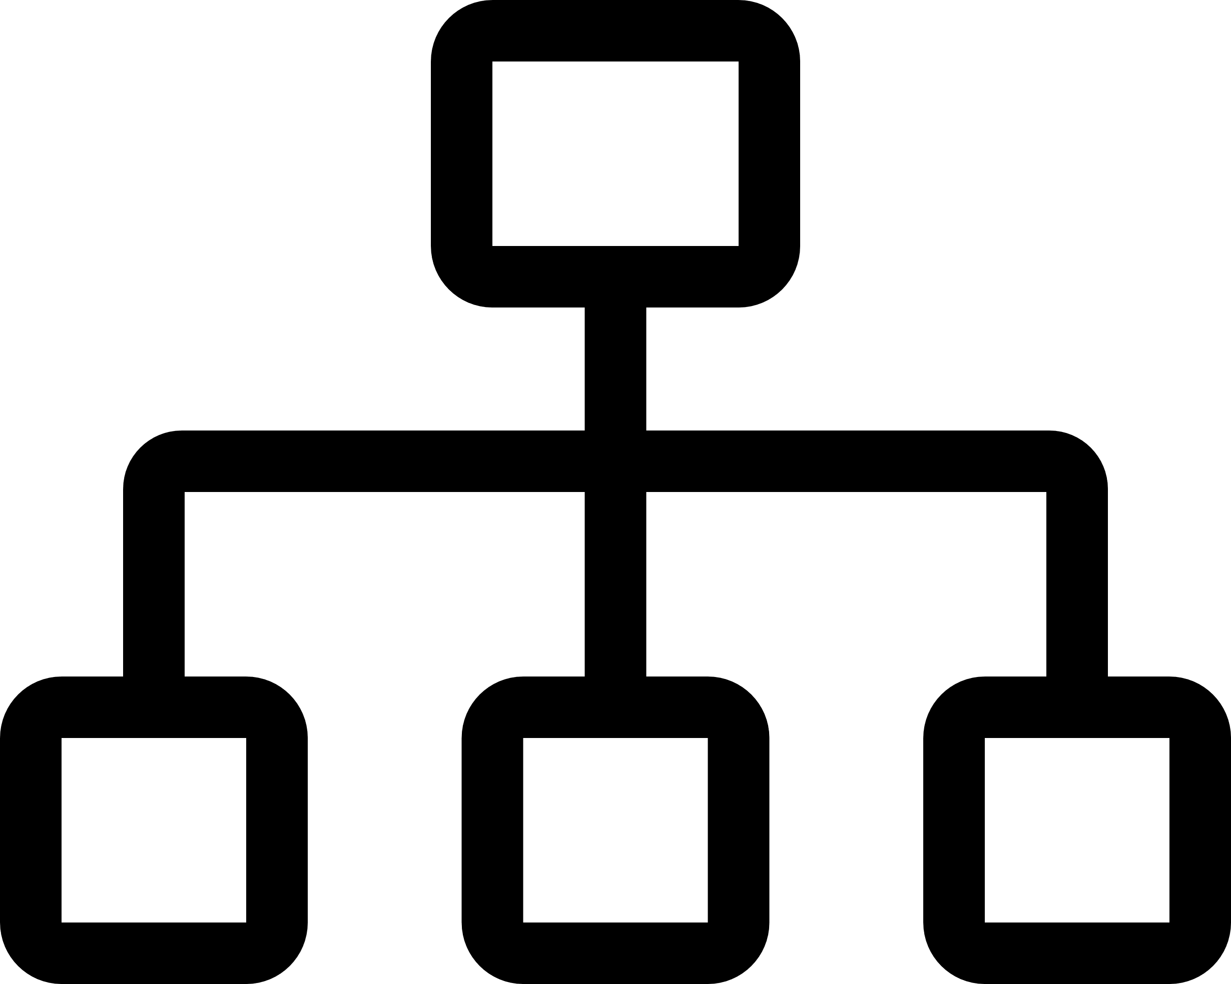



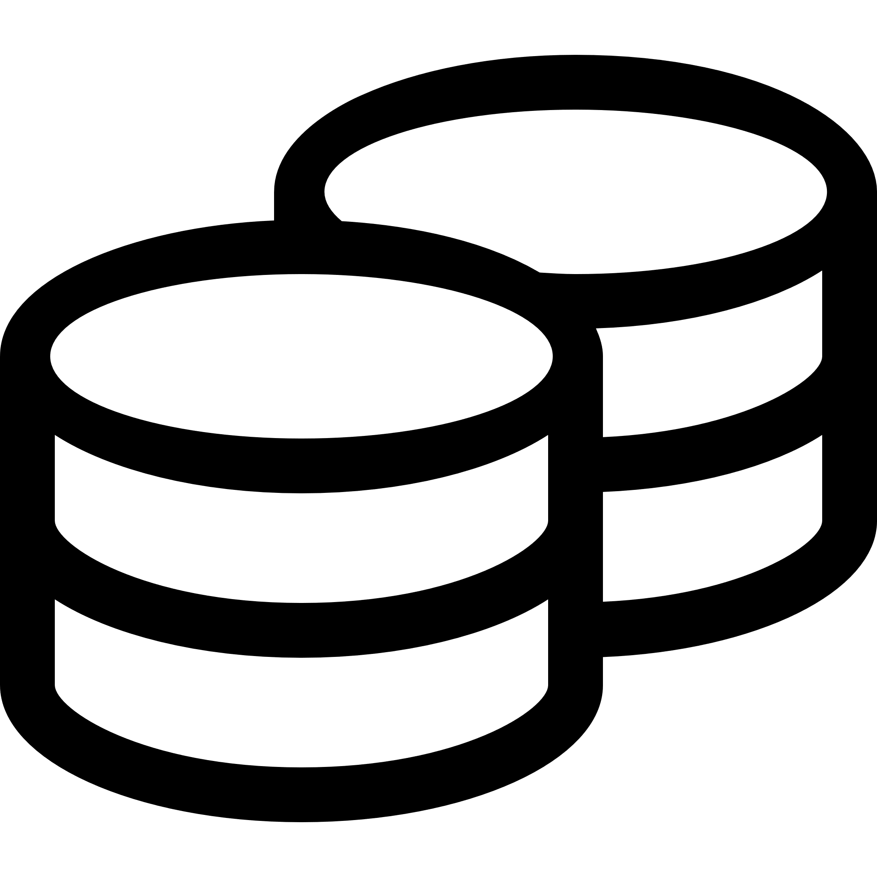






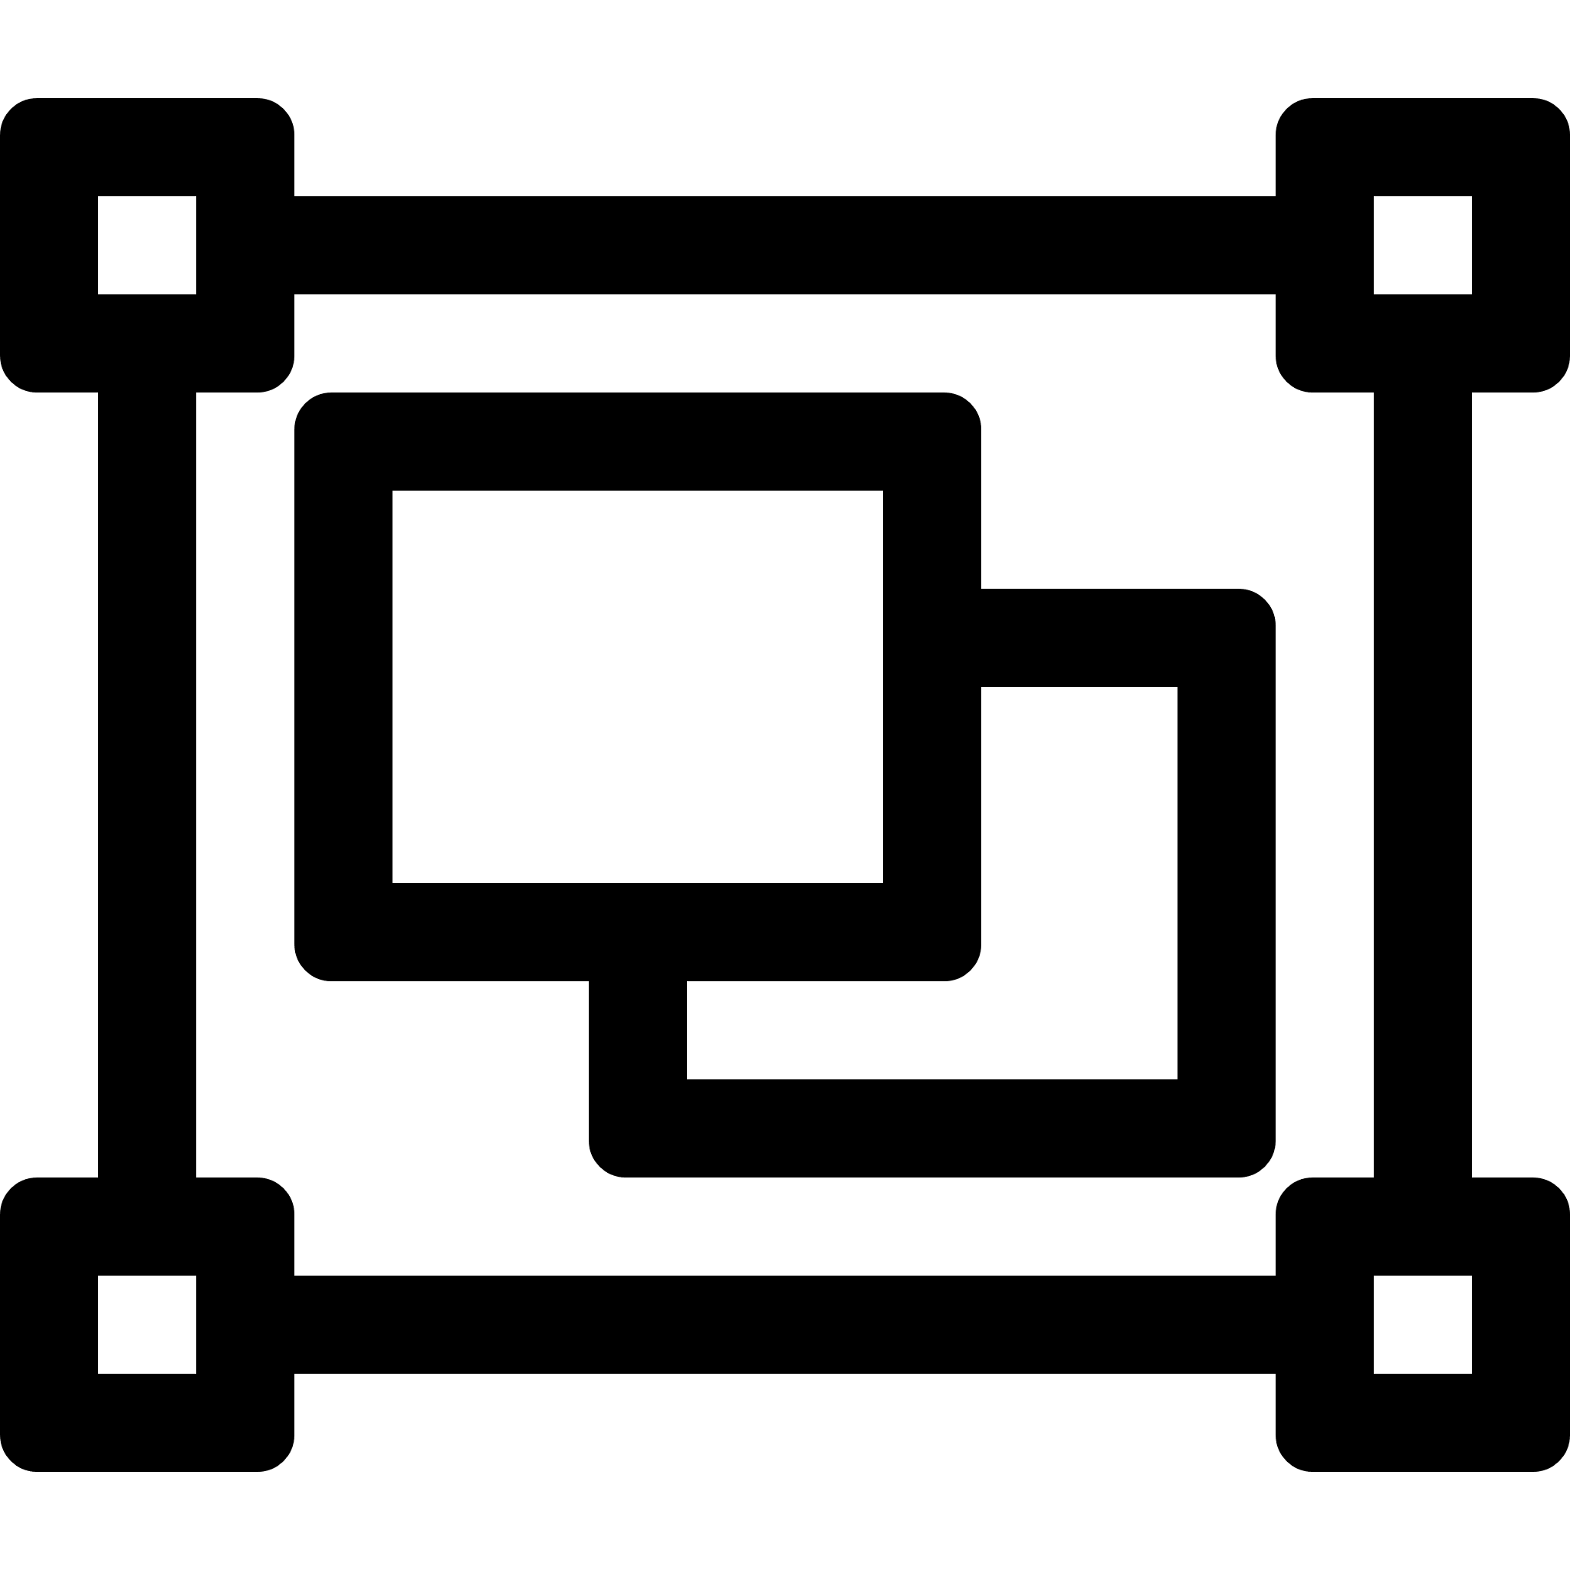
Kubernetes – A Modern Orchestrator
Easily load balance stateless services
Seamless integration with cloud providers
Extendable and pluggable
Auto scaling and hyper scale
Run stateful services with persistence
Health monitoring
Declaratively define applications
Rolling updates
Service failover & workload optimization
Secure with policies
Role based access
Multi-tenancy

Slide 13
Core Concepts and Terms
Node A worker machine (VM) normally clustered, each capable of running pods
Deployment A logical object for managing a replicated application (i.e. set of pods)
Label Metadata attached to any object for configuration and selection
Pod A group of one or more containers that is lifecycle managed
Service Network access to a resource, e.g. pod or port. Typically load balanced
Replica Set A set of one or more pods that is distributed and replicated across nodes

Slide 14



Highly Simplified Architecture
Kubernetes
Services
Node Cluster
( your apps/workloads )
Pods
Users
Master Cluster
Controller
Scheduler
API
Nodes
Developers
& Admins
Image Registry

Slide 15


Internal Architecture
Kubernetes
Cluster
Node
Users
kubelet
Container Runtime
Pod
Pod
Exposed services
…
kube
proxy
Pod
Master
…
Master
API Server
Scheduler
Node
Controller Manager
kubelet
Container Runtime
Pod
Devs / Operators
etcd
Pod
…
Cloud Controller
kube
proxy
Pod
Cloud Provider APIs

Slide 16


Highly Extensible / Unopinionated
Kubernetes Tool Box
Kubernetes is not a rigid pre-configured system
Extendable by design – many optional components
Defers to addons and extensions for specific tasks
Auto Scaler
Log Collection
Custom Resource
TLS Cert Manager
Dashboard
Ingress
External DNS
Admission Controller
Service Mesh
Helm

Slide 17
Core Components

Slide 18
Pods
Fundamental building block of Kubernetes
port: 8080
10.0.4.58
Pod
Pods run one or more containers
Containers in a pod share network/storage
Pods each have their own IP address
Pods expose one or more ports
Pods are scheduled and run on a Node
port: 8080
Container
A
Container B
shared network & filesystem
Example Pod
Pods are the primary way of running your workloads in Kubernetes

Slide 19
Deployments & Replica Sets
Scale and run pods across multiple nodes
Deployment
- name: MyApp
- replicas: 3
Deployments describe a replicated set of Pods
A Deployment represents desired state - Rolling updates used to safely roll out changes
You scale Deployments up & down
Deployments typically run stateless workloads
Deployments use ReplicaSets
ReplicaSet
- replicas: 3
pods
Deployments let you run & scale stateless workloads in Kubernetes

Slide 20
Services
Network access to Pods
Pods are ephemeral - they can move/die/change without notice. In general, users do not directly access Pods
Services are an abstraction which defines a logical set of Pods and a policy by which to access them
Services use labels and selectors to map to Pods
Services are assigned IP addresses and DNS names
Network Traffic
Service
pods
Services are how you connect to Pods over the network

Slide 21
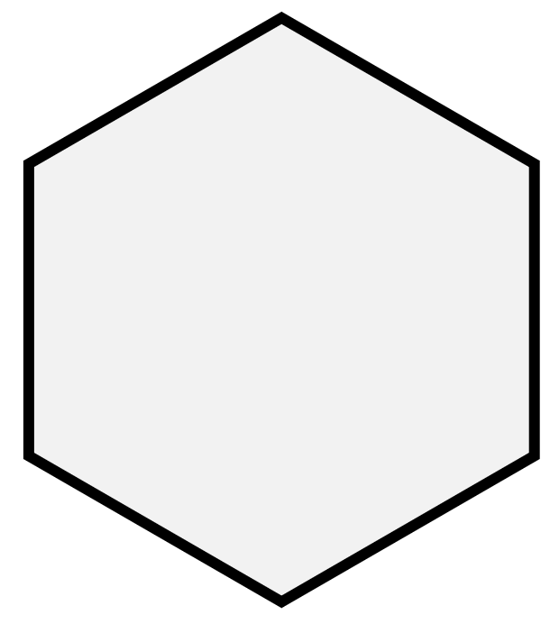
Services – Simplified Illustration
Allow virtual network access to one or more pods
label=myApp
Service
kube
proxy
myApp
myApp
Node 1
Service IP
selector: myApp port: 80 targetPort: 5000
kube
proxy
myApp
Node 2
EXTERNAL
INTERNAL
Note. Uses ‘round robin’ to select pods
LoadBalancer
Uses cloud provider to present an external load-balanced IP
ClusterIP
Internal virtual IP, only accessible by other pods/services

Slide 22
DNS and Service Discovery
Naming for Pods and Services
$ nslookup myapp
Address: 10.200.4.30
DNS in cluster is handled automatically by Kubernetes
All ClusterIP (internal) Services get assigned a DNS record based on the service’s name
Pods also get DNS names, but this is less useful
External public DNS can also be configured – See “Additional Network Services” section later
Service
- name: myapp
Service IP: 10.200.4.30
pods
Connect to your workloads using DNS and Services

Slide 23

Data Volumes & Mounts
Handling State & Data
Pod
Filesystem of running containers is ephemeral. All data written will be lost on a restart
Use Volumes to hold data or state you want to keep, or to inject data into a Pod
Volumes are mounted into a container at a mountPath
Many types of storage can be used to back the Volume
Container
/opt/data
Container
/var/www
Volume
datavol
Warning! A volume shares lifecycle with the Pod, so are not persistent
Volumes hold data and state for Pods and containers

Slide 24
Persistent Volumes
Pod
Handling State & Data
Container
/opt/data
Container
/var/www
A PersistentVolume allows you to hold data independent of Pod lifecycle
A pod uses a PersistentVolumeClaim to bind to a PersistentVolume - ReadWriteOnce - mounted on a single Node (e.g. db) - ReadWriteMany - mounted on multiple Nodes
Many storage plugins exist: NFS, iSCSI, Azure (Disk & Files), CSI, Ceph, Gluster, AWS
Volume
datavol
PersistentVolumeClaim
PersistentVolume
pv1
Persistent Volumes retain data long term, outside of Pods

Slide 25
Stateful Sets
Handling Stateful workloads
StatefulSet
- name: MyDbSet - serviceName: "mongo"
- replicas: 2
A StatefulSet is like a Deployment except Pods get well defined names and replicas start in ordered sequence
StatefulSets retain identity regardless of which Node they run on
Each Pod in a StatefulSet will bind to the same defined PersistentVolumeClaim
mongo-0
mongo-1
pvc-mongo-0
pvc-mongo-1
Use a StatefulSet rather than Deployment for stateful workloads

Slide 26
Daemon Sets
Running Pods across all Nodes
A DaemonSet ensures that all Nodes in the cluster run a given Pod. Pods will be created/removed as Nodes are added/removed
Used for special system and cluster daemons, logging, storage, etc.
DaemonSets are not often used for normal app workloads
Node
1
Node
2
Node
n
DaemonSet
DaemonSets run system Pods for monitoring & network

Slide 27
Jobs & CronJobs
kind: Job
spec:
completions: 1
parallelism: 3
Workloads that run to completion
A Job creates one or more pods and ensures that a specified number of them successfully terminate
Jobs can run in serial or parallel
Control of number of failures, completions, restart policy and level of parallelism
CronJobs allows you to schedule Jobs to be run
Job
c1
c2
c3
c3 → Terminated: Complete Job → Successful
Use Jobs for any workloads that run in batch or perform one off tasks

Slide 28
Namespaces
Logical Separation & Cluster Organisation
Kubernetes Cluster
Most Kubernetes objects live inside a Namespace
Kubernetes starts with two Namespaces: default and kube-system
You can create Namespaces to logically partition a cluster, e.g. for dev/test or different customers
Nodes will be shared across Namespaces
A namespace does not provide isolation & multi-tenancy
Namespace
“alpha”
Namespace
“beta”
pod
pod
pod
svc
Node
1
Node
2
Node
3
When first learning Kubernetes use the default Namespace

Slide 29



Role Based Access Control (RBAC)
User
ServiceAccount
Regulating & governing access
RBAC controls user and system access to the API and Kubernetes resources
Roles define privileges as sets of verbs and API resources
RoleBinding grants Roles to Users and ServiceAccounts
RoleBinding
kind: Role
name: pod-reader
rules:
resources: ["pods"]
verbs: ["get", "watch", "list"]
get, delete, create, list, update, watch
Verb:
pods, secrets, services,
jobs, nodes, ingresses
Note. Kubernetes doesn’t include a native identity system or a way to manage end user accounts
API:
RBAC is optional, but a standard feature for any new cluster

Slide 30

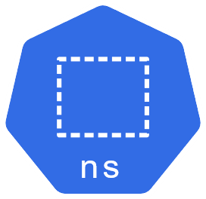
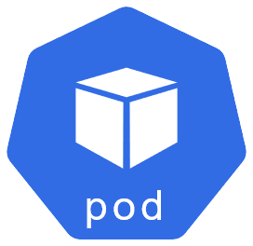
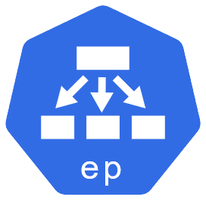
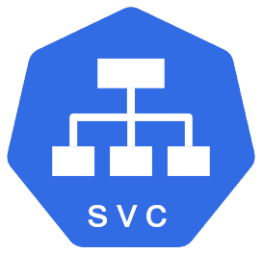
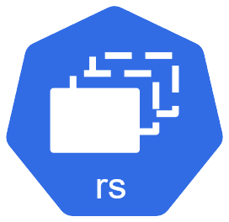
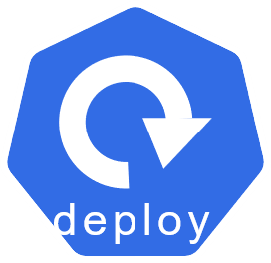
Putting It All Together
Sample Architecture – Simple App
Basic web application
Running in 3 pods via a Deployment and ReplicaSet
With LoadBalancer service and external IP
namespace: default
External IP

Slide 31
Using Kubernetes

Slide 32
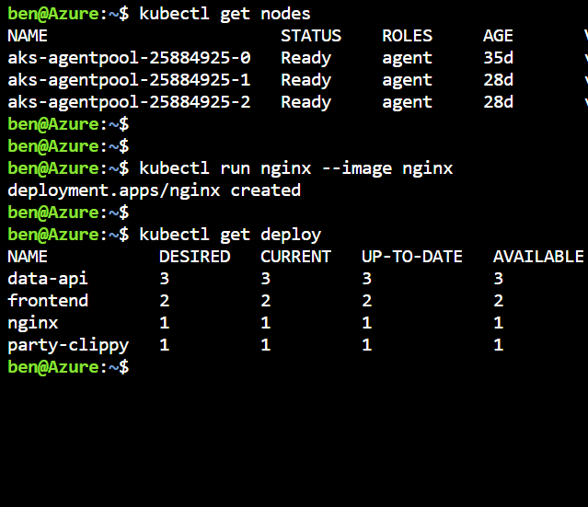
Command Line - kubectl
Main management & control interface to Kubernetes
Single executable binary
Can manage multiple clusters
Secure interface to Kubernetes API
Used for cluster ops and application deployment & management

Slide 33

Kubectl – Common Commands
get
delete
apply
run
describe
Display one or many resources
Delete resources
Create resources from YAML
Directly start and run pods
Get details of any resource
get nodes
get pods
get all
get pod/myPod
get nodes -w
delete deploy/mydeploy
delete -f myapp.yaml
delete -l app=foo
apply -f myapp.yaml
run nginx --image=nginx --replicas=3
run myapp
--image=foo/img
--port=8080
describe pod/pod138
describe svc/myservice
describe pod -l app=myapp
kubernetes.io/docs/reference/kubectl/cheatsheet
kubernetes.io/docs/reference/kubectl/overview

Slide 34
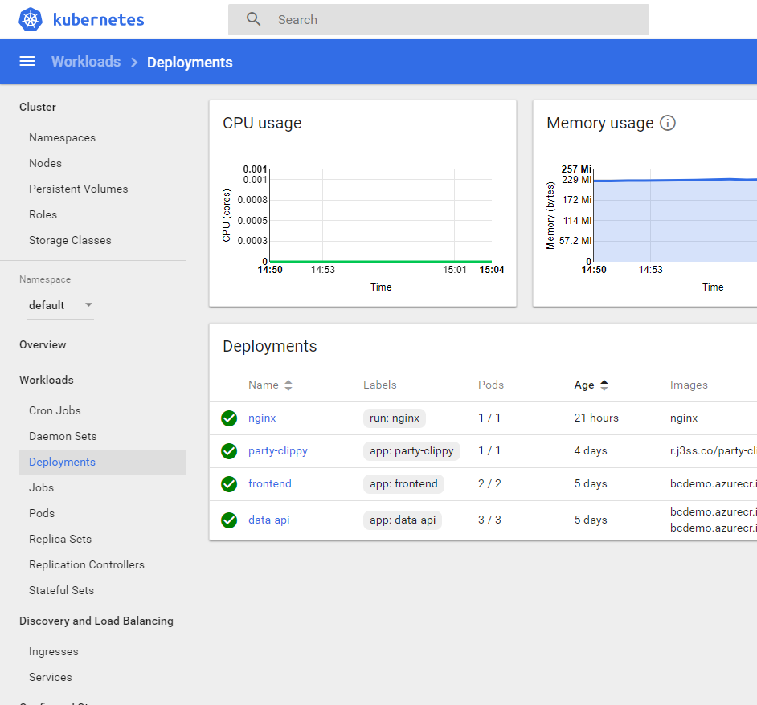
Dashboard
Official management web UI
Useful when learning
Not secure, should never be exposed publicly
Optional, not deployed by default
https://github.com/kubernetes/dashboard

Slide 35

Kubernetes Object Management
Three methods of managing Kubernetes
kubernetes.io/docs/concepts/overview/object-management-kubectl
Management Technique | Operates On | Recommended Environment | Learning Curve | Infrastructure As Code
Imperative commands | Live objects | Dev projects | Lowest | No
Imperative object configuration | Individual files | Production use | Moderate | Limited
Declarative object configuration | Individual & multiple files | Production use | Highest | Yes
File based declarative object configuration is the most common approach used

Slide 36
Introduction to the Declarative Model
YAML or JSON documents
Describe any Kubernetes object
Objects & properties map directly to the Kubernetes API
You can combine multiple objects into a single file (separate with ---)
kind: Deployment
apiVersion: apps/v1
metadata:
name: mydeploy
spec:
replicas: 4
selector:
matchLabels:
app: myapp
template:
metadata:
labels:
app: myapp
spec:
containers:
- name: mycontainer
image: bencuk/vuego-demoapp
ports:
- containerPort: 4000
This is a deployment object, called ‘mydeploy’
It will run 4 replicas of a pod matching the label app=myapp
Each pod will be labelled with app=myapp and
Runs a container from image bencuk/vuego-demoapp
Port 4000 will be exposed from the container
Note. JSON is also supported, but YAML is recommended for readability

Slide 37

Idempotent Updates & Desired State
Files describe desired state of the resources you configuring
kubectl apply
Kubernetes applies updates in idempotent way, modifying objects only if needed
$ kubectl apply –f myconfig.yaml
deployment.apps/mydeploy created
$ nano myconfig.yaml
myapp.yaml
spec:
replicas: 4
spec:
replicas: 2
$ kubectl apply –f myconfig.yaml
deployment.apps/mydeploy configured
Idempotency: “The definition of the target state can be applied multiple times and if the system’s state is unchanged, no changes are made to the system”

Slide 38
Labels & Selectors
kubernetes.io/docs/concepts/overview/working-with-objects/labels
Kubernetes makes extensive use of labels and selectors
Labels are metadata on any object and are just key:value pairs of your choosing
Selectors are lookups that match one or more objects based on their labels
kind: Deployment
...
metadata:
labels:
app: myapp
type: frontend
---
kind: Service
spec:
type: LoadBalancer
selector:
app: myapp
This is a deployment labels its pods with app: myapp & type: frontend
This service will look for any pods labelled with app=myapp
Note. There might be zero, one or many matches
Uses
- Which pods are in a service - Which nodes to run a pod on - Which pods are in a deployment - Logically group & tag resources

Slide 39
Configuring Basic Workloads

Slide 40
Environmental Variables
kubernetes.io/docs/tasks/inject-data-application/define-environment-variable-container/
Environmental variables are the standard way to configure containers at runtime
Containerized app consumes environmental variables in OS standard way
Key value pairs
Application/container specific
apiVersion: v1
kind: Pod
metadata:
name: envar-demo
labels:
purpose: demonstrate-envars
spec:
containers:
- name: envar-demo-container
image: gcr.io/google-samples/node-hello:1.0
env:
- name: DEMO_GREETING
value: "Hello from the environment"
- name: DEMO_FAREWELL
value: "Such a sweet sorrow"
Uses
Application configuration
Parameter passing

Slide 41
Secrets
kubernetes.io/docs/concepts/configuration/secret
Hold sensitive information such as passwords, certs and API keys
Don’t place sensitive values as plain text in deployment files
Don’t “bake” secrets into your container images with config files
Can be mounted in pods as files or environmental variables
$ kubectl create secret generic my-secret --from-literal connString='admin:superSecret@some-host'
secret/my-secret created
myapp.yaml
containers:
- name: my-web-server
env:
- name: DATABASE_CONNECTION_STRING
valueFrom:
secretKeyRef:
name: my-secret
key: connString
Uses
TLS certificates
Application configuration
Authentication with private registry

Slide 42
ConfigMaps
kubernetes.io/docs/tasks/configure-pod-container/configure-pod-configmap
Hold application configuration data
Key value pairs (like secrets), YAML or free format (e.g. XML, conf)
Pass to containers as env vars or mount as volume
$ kubectl create configmap my-config --from-file=/path/to/foobar.conf
configmap/my-config created
myapp.yaml
containers: - name: my-foobar-server
volumeMounts:
- name: config-vol
mountPath: /etc/config
volumes:
- name: config-vol configMap: name: my-config
Mount into container at given path
Uses
Application configuration
Reference to config map object

Slide 43
Resource Management
kubernetes.io/docs/concepts/configuration/manage-compute-resources-container
Define compute (CPU & memory) resource limits and requests for containers
Allows Kubernetes to make better scheduling placement decisions
Limits are enforced, requests aren’t
CPU resources are fractions of 1 vCore
apiVersion: v1
kind: Pod
metadata:
name: demo-app
spec:
containers:
- name: db
image: mysql
resources:
requests:
memory: "64Mi"
cpu: "0.25"
limits:
memory: "512Mi"
cpu: "2.0"
Uses
Efficient use of cluster resources
Prevent rogue workloads starving the cluster
Good practice
Certain capabilities such as auto scaling are dependant on setting resources
Specifying limits & requests is optional but STRONGLY recommended

Slide 44
Liveness & Readiness Probes
kubernetes.io/docs/tasks/configure-pod-container/configure-liveness-readiness-probes
Liveness probes tell Kubernetes your container is “alive”
Readiness probes tell Kubernetes your container is ready to accept traffic
Liveness probe failure can restart the container if it has hung
HTTP, TCP and command checks
...
livenessProbe:
httpGet:
path: /status
port: 8080
initialDelaySeconds: 25
periodSeconds: 10
failureThreshold: 3
...
readinessProbe:
exec:
command: ["mysqladmin", "ping"]
initialDelaySeconds: 30
periodSeconds: 20
Uses
Maintain availability
Restart/termination of unhealthy containers
Efficient traffic routing
Specifying a liveness probe is optional but recommended

Slide 45
Commands & Arguments
kubernetes.io/docs/tasks/inject-data-application/define-command-argument-container/
Using the command property pass a starting command to a container
Use args to pass arguments to the container, pass an array of strings
Note. These correspond to the Docker Entrypoint and Cmd parameters
kind: Pod
metadata:
name: command-demo
spec:
containers:
- name: command-demo-container
image: debian
command: ["printenv"]
args: ["HOSTNAME", "KUBERNETES_PORT"]
Description | Docker field name | Kubernetes field name
The command run by the container | Entrypoint | command
The arguments passed to the command | Cmd | args
Uses
Use base images to run utilities & scripts
Debugging & trouble shooting
Application configuration
Parameter passing

Slide 46
Beyond The Basics

Slide 47



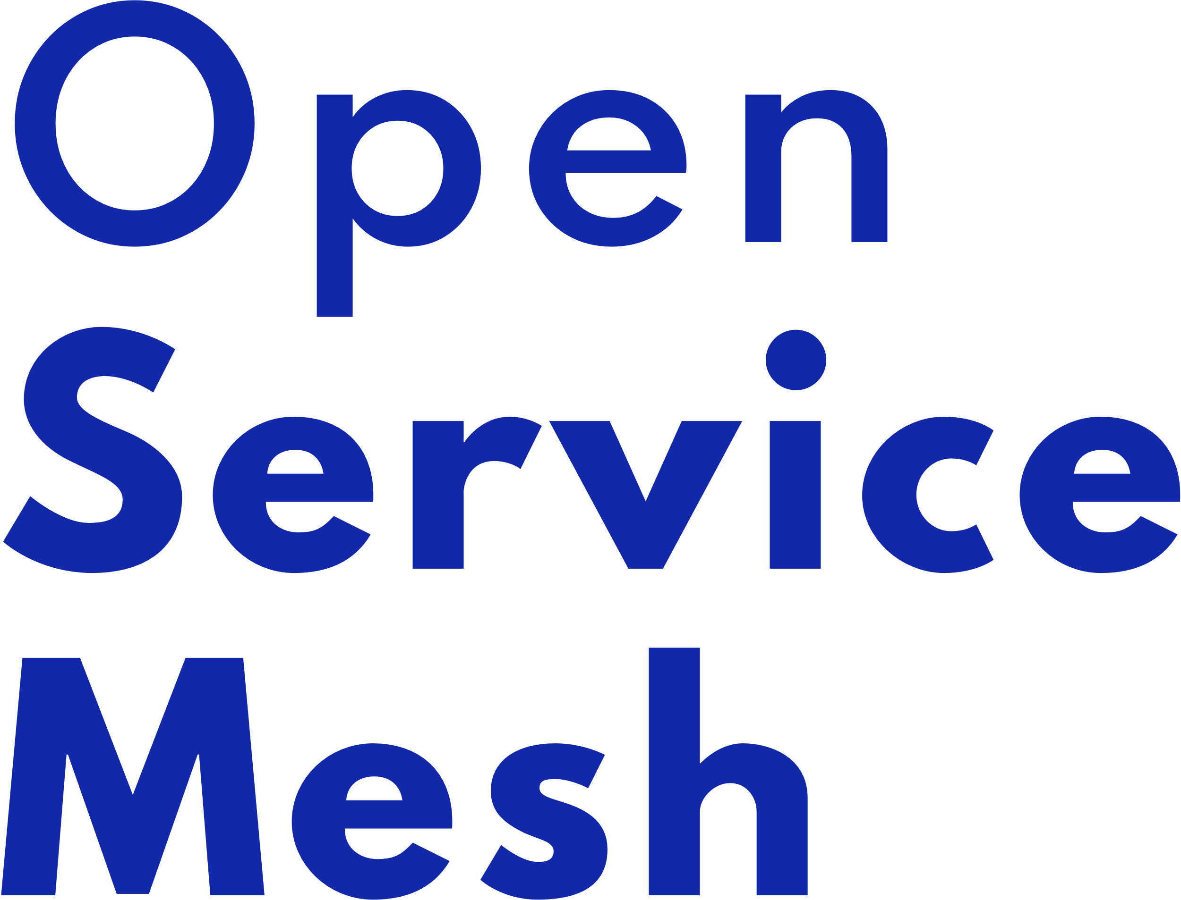

Service Mesh
https://servicemesh.io/
Facilitates services to service calls inside Kubernetes
Features:
Observability / tracing
Error handling / retries / backoff
Encryption / mTLS
Routing / balancing
Traffic splitting: blue-green / canary
Typically runs as a proxy sidecar in all your pods
Adds complexity & overhead
Istio

Slide 48

















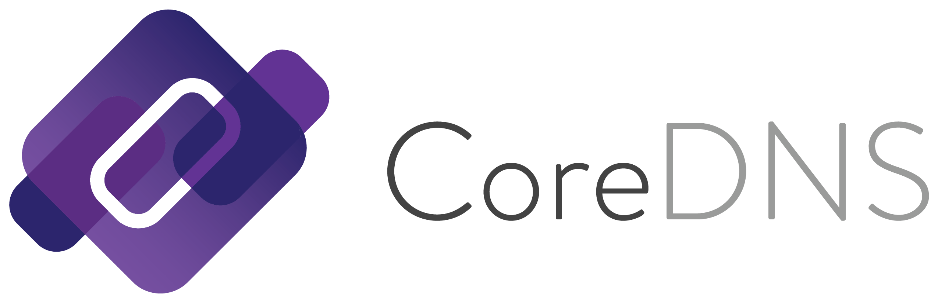
Kubernetes Ecosystem – Many Projects
Security / Policy
DevOps
Serverless
Monitoring
Helm
Flux
Prometheus Grafana
Opentracing
Gatekeeper
Kubeless
Network Plugins
Load Balancing & Discovery
Storage
Calico
Weave Net
Flannel
Envoy
Linkerd
CoreDNS
Portworx
Rook
landscape.cncf.io

Slide 49
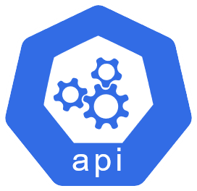
The Kubernetes API
kubernetes.io/docs/reference/#api-reference
It’s Kind Of Important!
Every object in Kubernetes and any interactions with the cluster are shaped by the API and the API spec - YAML manifests schema - kubectl commands
Served by the API server running on master node(s)
Kubernetes version dependant
Aggregated - hosts multiple APIs at multiple versions
kubectl proxy – Create a local tunnel to the API server

Slide 50
Additional Network Services

Slide 51

Ingress
External access for HTTP and HTTPS
An Ingress allows you to route HTTP/HTTPS traffic to services based on URL and/or domain host name
Ingress object is a set of rules picked up and implemented by the Ingress Controller
Ingress Controller has a public IP and LoadBalancer service, it routes traffic to internal ClusterIP services
A large choice of controllers are available, e.g. NGINX
Ingress
/site/live
/site/test
pod
pod
Use an Ingress when you want to route HTTP(S) traffic into your workloads and pods

Slide 52
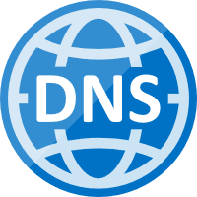
External DNS
A record: foo.example.com
IP: 52.55.80.100
Optional Addon – Auto configuration of public DNS
Allows for dynamic configuration of DNS records
Seamlessly keep public DNS in sync with your Ingress and external services
Supports Azure DNS, AWS, CloudFlare, Google DNS etc
SIG project: github.com/kubernetes-sig/external-dns
example.com
52.55.80.100
foo
external dns
foo
Commonly used with an Ingress for host based external routing

Slide 53

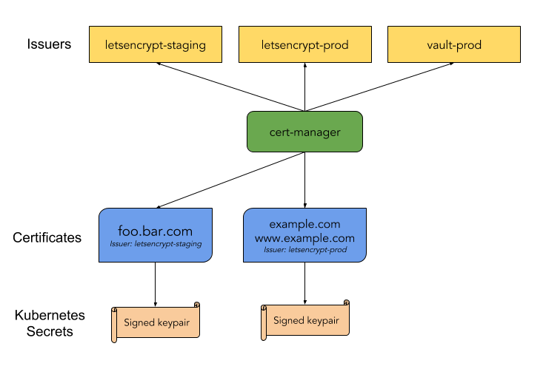
Cert Manager
github.com/jetstack/cert-manager
Optional Addon – Automate issuing of TLS certs
Ensures certificates are valid and up to date
Tightly coupled to Ingress, e.g. host rules
Renew certificates before expiry
Uses ACME issuers, i.e. Let’s Encrypt
Project: https://cert-manager.io
Issue TLS certs for HTTPS access to services & Ingress

Slide 54
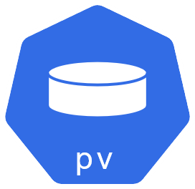
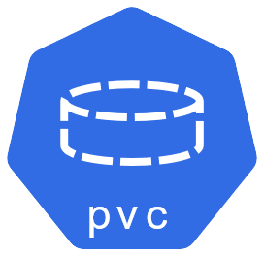

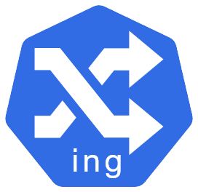
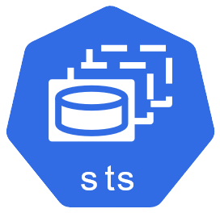
Putting It All Together
Sample Architecture – Complex App
Multi component web application, with API & DB
Ingress routing traffic to web and API pods
Ingress is exposed
to the internet
Database running in StatefulSet with internal only service and using PVC for storage, plus secrets
web
data
web
web-deployment
database
api
api-deployment

Slide 55
Debugging and Troubleshooting Workloads

Slide 56
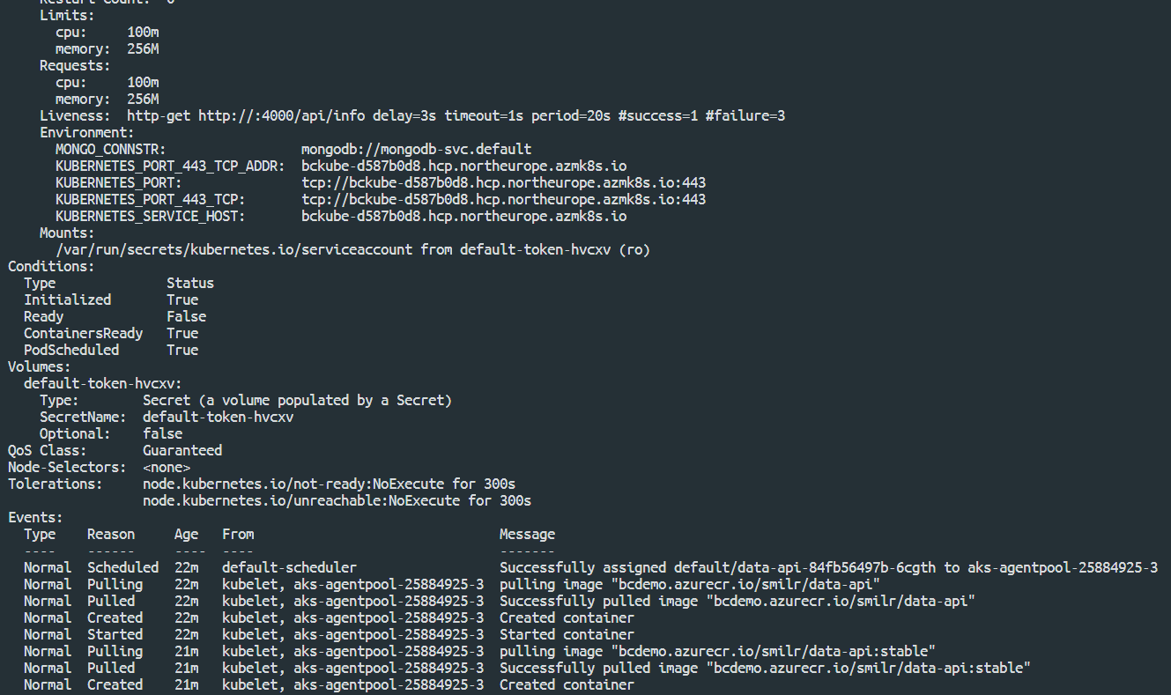
Describing Objects
kubernetes.io/docs/tasks/debug-application-cluster
Use kubectl describe to inspect status of any object in your cluster
Returns events and all properties & status details
Use label selectors to query multiple objects
$ kubectl describe deploy/data-api
$ kubectl describe pod/data-api-84fb56497b-6cgth
$ kubectl describe service/frontend
$ kubectl describe pod –l app=data-api
Uses
View and understand the status of anything in your cluster
Troubleshoot pending/failed workloads

Slide 57
Container Logs
Access stdout & stderr output from pods with: kubectl logs
Get output from a deployment or pod or single container
Follow logs with -f
$ kubectl logs deploy/data-api
Found 3 pods, using pod/data-api-84fb56497b-6cgth
> smilr-data-api@3.2.0 start /home/app
> node server.js
### Node environment mode is 'production'
### Connection attempt 1 to MongoDB server mongodb-svc.default
### Yay! Connected to MongoDB server
### Server listening on 4000
Uses
View any errors output from containers
See what your workloads are doing

Slide 58
Get Shell Access
kubernetes.io/docs/tasks/debug-application-cluster/get-shell-running-container
Create processes in running containers
Use kubectl exec
Use -it switch and sh or bash to create an interactive shell
Can also run a single non-interactive command
$ kubectl exec frontend-58b84f7d7-fb6rg -- ps -ef
PID USER TIME COMMAND
1 root 0:00 npm
22 root 0:00 node server.js
36 root 0:00 ps –ef
$ kubectl exec -it frontend-58b84f7d7-fb6rg -- bash
bash-4.4# ls -a
node_modules package.json server.js
bash-4.4# uname
Linux
Uses
Low level debugging
Interactive troubleshooting

Slide 59
Advanced Pod Configuration

Slide 60
Deeper Dive on Manifests
?? So what do all these labels mean ??
Manifests for Deployments, StatefulSets and DaemonSets have a similar pattern & structure
The spec part contains replicas and a selector and also a template for the objects it will replicate
The template will contain another spec, typically a Pod spec
A Pod spec contains one or more containers
kind: Deployment
apiVersion: apps/v1
metadata:
name: my-deployment
labels:
cheese: cheddar
spec:
replicas: 1
selector:
matchLabels:
thing: my-app
template:
metadata:
labels:
thing: my-app
cake: chocolate
spec:
containers:
- name: my-container
image: nginx
Deployment name will also be used as name prefix for the
ReplicaSet and Pods
Labels for the deployment are
optional
The selector of the spec MUST match one label in the template
Required field but mostly not important

Slide 61
Init Containers
kubernetes.io/docs/concepts/workloads/pods/init-containers
Init Containers are optional special containers that run only once when a pod is started
Init containers run to completion (terminate)
Main containers in a pod will not start until all Init Containers have run
...
initContainers:
- name: init-mysql
image: bencuk/mysqldb
command: ["./scripts/checkDB"]
...
initContainers:
- name: init-demodata
image: bcdemo.azurecr.io/smilr/data-api
command: ['sh', '-c', 'cd demoData && node demodb.js']
env:
- name: MONGO_CONNSTR
value: mongodb://mongodb-svc.default
- name: WIPE_DB
value: "true"
Uses
Application configuration
Bootstrapping apps
Running utility & start-up scripts
Data injection

Slide 62
Node Selector
kubernetes.io/docs/concepts/configuration/assign-pod-node/#nodeselector
kind: Pod
metadata:
name: machineLearning
spec:
containers:
- name: trainModel
image: ml-image:latest
nodeSelector:
hardware: gpu
Pod
A simple constraint to which Nodes are eligible to run a Pod
Key value pairs of labels, to be matched against Node’s labels
Not a ‘hard rule’, other Pods that have no nodeSelector can still land on the node
Can be scheduled on
Name: aks-nodepool1-18655374-vmss000000
Roles: agent
Labels: agentpool=nodepool1
beta.kubernetes.io/arch=amd64
hardware=gpu
Uses
Node
Assign workloads requiring special hardware or resources, e.g. GPU
Physical partitioning of cluster
Separating noisy Pods

Slide 63
Affinity and Taints
kubernetes.io/docs/concepts/configuration/taint-and-toleration/
kubernetes.io/docs/concepts/configuration/assign-pod-node/#affinity-and-anti-affinity
$ kubectl taint nodes myNode001 team=team1:NoSchedule
node/myNode001 tainted
kind: Pod
spec:
tolerations:
- key: team
operator: Exists value: "team1"
effect: NoSchedule
Affinity and anti-affinity provide advanced ways to control Pod placement - ‘Hard’ rules and ‘soft’ rules - Weighting and expressions
Taints and Tolerations. Taints are applied to Nodes and will not accept Pods that don’t have a matching Toleration
Unlike taints & nodeSelectors, affinity rules can also apply to pods. i.e. do or don’t schedule these pods together
kind: Pod
spec:
affinity:
nodeAffinity:
requiredDuringSchedulingIgnoredDuringExecution:
preferredDuringSchedulingIgnoredDuringExecution:
podAffinity:
requiredDuringSchedulingIgnoredDuringExecution:
preferredDuringSchedulingIgnoredDuringExecution:
Uses
Assign workloads requiring special hardware or resources, e.g. GPU
Physical partitioning of cluster
Separating noisy Pods

Slide 64
Sidecars
kind: Pod
metadata:
name: monitored-webapp
spec:
containers:
- name: webserver
image: nginx
- name: log-monitor
image: my-log-monitor
args: ["--log-dir", "/var/logs/nginx"]
Pods co-locate multiple containers together, sharing network and storage
Sidecar is a pattern where additional containers provide enhancing/optional capabilities
Bind containers together to form a single cohesive unit of service
Pod
Container
nginx
Container
(sidecar)
logmon
Uses
Decompose architecture
Build services incrementally
Bolt on features
/var/logs/nginx

Slide 65
Scaling

Slide 66
Manually Scaling
Scale stateless workloads by controlling the number of replicas of a Deployment
Be careful scaling StatefulSets, unless the workload/application is “cluster aware”
DaemonSets don’t require scaling
$ kubectl scale deploy/myApp --replicas=5
deployment.extensions/myApp scaled
OR
kind: Deployment
apiVersion: apps/v1
metadata:
name: myApp
spec:
replicas: 2
Uses
Horizontally scale
Distribute work around cluster
Remove single points of failure
5

Slide 67
Horizontal Pod Autoscaler (HPA)
Automatically scale stateless workloads
Use to horizontally scale stateless Pods in ReplicaSet/Deployment
Rules define desired Pod replica count based on observed metrics
Takes metrics from the metrics API fed from the Metrics Server (
Supports extension via custom metrics
pod 1
…
pod n
Deployment
Scale
metrics data
- Increase replicas
- Decrease replicas
Metrics Server
Horizontal Pod Autoscaler
Dynamically scale stateless workloads across available nodes

Slide 68

Cluster Autoscaler (CA)
Automatically scale cluster resources
Additional node(s) needed
CA
Pods are in pending state
Adjusts the size of the Kubernetes cluster, adding & removing Nodes when - Pods are pending state due to insufficient resources (scale out) - Nodes have been underutilized for a period of time (scale in)
Tightly coupled to the cloud and environment hosting the cluster & Nodes
Pod
Pod
New Node is brought online
Pending pods are scheduled
Node
New Node
Pod
Pod
Pod
Pod
Kubernetes Cluster
Scale cluster wide by adding/removing Nodes

Slide 69
Extending Kubernetes
Extra Advanced

Slide 70
Custom Resources Definitions (CRDs)
Extend the Kubernetes API and object model
apiVersion: apiextensions.k8s.io/v1
kind: CustomResourceDefinition
spec:
names:
plural: pets
kind: Pet
openAPIV3Schema:
type: object
properties:
petName:
type: string
An extension of the Kubernetes API that is not available in a default Kubernetes installation
Can represent application specific or generalised entities, e.g. BackupJob, Report
A CRD is schema & state – doesn’t define behaviour
Manage via the API & kubectl same as standard built-in resource types
$ kubectl get pets
Extend Kubernetes with new entities and data models

Slide 71
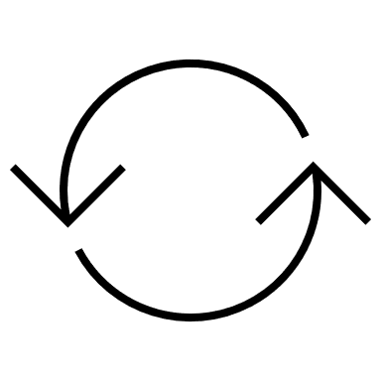
Operators
The Operator pattern: CRD + Custom Controller
crud
Custom Resource
An operator is custom controller that acts on a given set of CRDs – defines behaviour
Controller is run as a regular pod & deployment
Custom operator reconciler code subscribes to the Kubernetes API & watches for CRD changes
user
tracking
change
events
Operator
state
reconcile
Discover & use:
artifacthub.io
operatorhub.io
Build your own:
Kubebuilder
KUDO
Operator SDK
A common and easily understood way to extend Kubernetes

Slide 72
DevOps

Slide 73







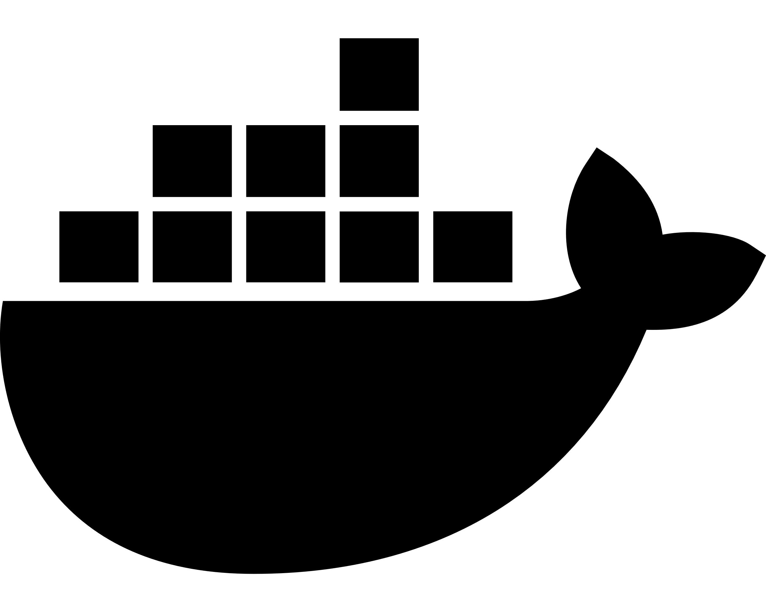
Common DevOps Containers Lifecycle
CI/CD flow with pipelines/workflows and Helm
CI
CD
git
Container Build
Pipeline
Trigger / Webhooks
Container Registry
Release
Pipeline
Inner Loop
Test
$ docker build/run
$ git push
Feedback / Fixes
Staging
Observability / Events
Prod
Develop

Slide 74
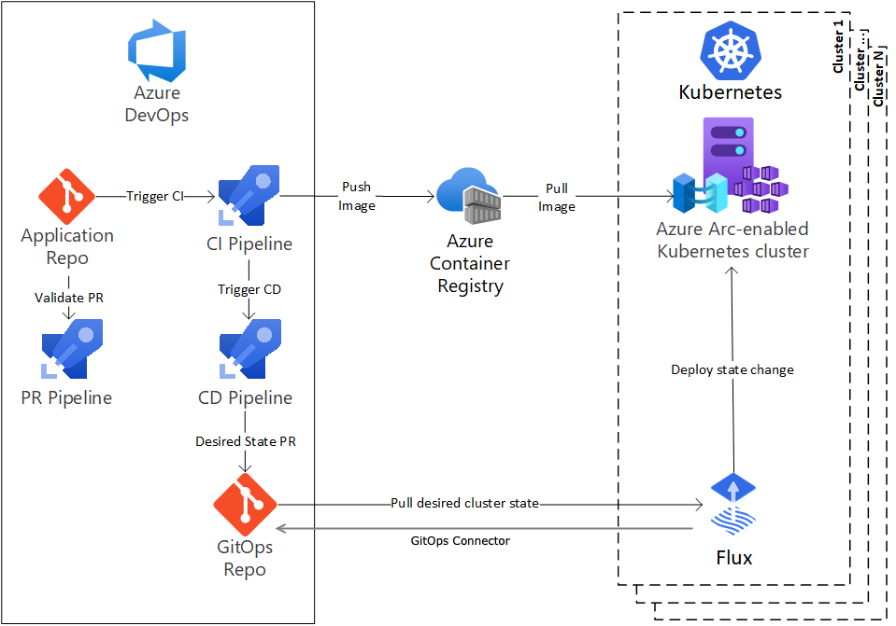
GitOps
Declarative approach to IaC & continuous deployment
GitOps is new approach & a set of practices & tools to manage infrastructure & application configurations using Git.
A “pull” approach vs “push” – special controllers (e.g. Flux) in Kubernetes watch and poll for changes and reconcile the updates.
More complex & not as well adopted as the Helm/kubectl push CD flow but has some advantanges.
Alternative approach for managing and deploying applications to Kubernetes

Slide 75
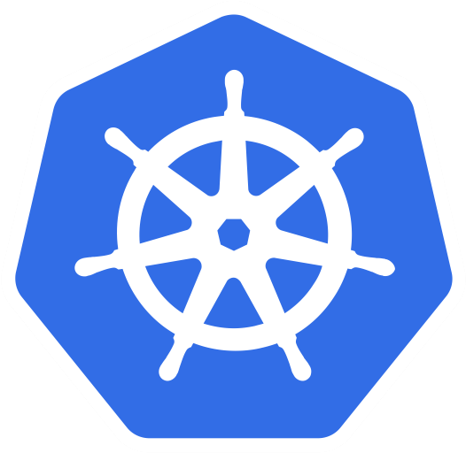
Cluster Isolation Patterns: Physical Isolation
Dev Cluster
Staging Cluster
Node0
Node1
Node0
Node1
PodA
PodB
PodE
PodF
PodA
PodB
PodE
PodF
PodC
PodD
PodG
PodH
PodC
PodD
PodG
PodH
Prod Team1 Cluster
Prod Team2 Cluster
Node0
Node1
Node0
Node1
PodA
PodB
PodE
PodF
PodA
PodB
PodE
PodF
PodC
PodD
PodG
PodH
PodC
PodD
PodG
PodH
Simple but can waste resources, management overhead

Slide 76
Cluster Isolation Patterns: Logical Isolation
Dev and Staging Cluster
Prod Cluster
Node0
Node1
Node0
Node1
DevTeam1
Team1
Pod
Pod
Pod
Pod
Pod
Pod
Pod
Pod
Pod
Pod
Pod
Pod
Staging
Pod
Pod
Pod
Pod
Team2
Node2
Node3
Node3
Node4
Pod
Pod
Pod
Pod
Pod
Pod
Pod
Pod
Pod
Pod
Pod
Pod
DevTeam2
Pod
Pod
Pod
Pod
Team3
Requires planning & some Kubernetes expertise

Slide 77

Helm
Package Manager for Kubernetes
Helm simplifies deployment into Kubernetes using charts
A chart consists of one or more Kubernetes YAML templates + supporting files
Helm charts support dynamic parameters & functions important for automated pipeline deployments
Thousands of charts exist for standard software, tools & packages
https://helm.sh
- Use Helm to install software/apps in your cluster - Create Helm charts for your own apps, for CI/CD releases

Slide 78

Helm – The Basics
docs.helm.sh/glossary
helm | Client tool to manage and work with Helm
Chart | Package of Kubernetes resources in template form
Template | Kubernetes YAML with directives in Go template language format, e.g. {{ blah }}
Release | When installing a chart into Kubernetes it becomes a release
Values | Used at install time to customise the release, either from CLI or file
Dependency | A chart can require other external charts, Helm will automatically pull/update
Chart: mychart/
+
values.yaml
+
helm
foo Pods
foo-pods
$ helm install foo ./mychart -f values.yaml
Release:
foo
foo Services
foo-services

Slide 79
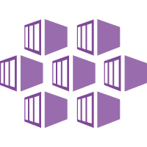
Azure Kubernetes Service

Slide 80
Managed Kubernetes on Azure – AKS
Azure managed control plane
Automated upgrades, patches
High reliability, availability
Easy, secure cluster scaling
Self-healing
API server monitoring
At no charge
App/ workload definition
Self-managed master node(s)
Kubernetes API endpoint
etcd Store
User
API server
Controller Manager
Cloud Controller
Scheduler
Azure Kubernetes Service AKS
Azure core network
Customer Nodes
Container Runtime
Container Runtime
Container Runtime
Container Runtime
Container Runtime
Pods
Pods
Pods
Pods
Pods

Slide 81
AKS Networking Models
Node: 192.168.0.10
Node: 192.168.0.11
Node: 192.168.0.10
Node: 192.168.0.20
Pods: 10.244.1.0
Pods: 10.244.2.0
Pods:
192.168.0.11, 12, 13
Az CNI
Pods:
192.168.0.21, 22, 23
Az CNI
veth bridge
kubenet
veth bridge
kubenet
VNet
VNet
10.244.2.0 → 192.168.0.11
Subnet: 192.168.0.0
Subnet: 192.168.0.0
udr
Basic
Advanced
Uses kubenet network plugin
Pods are not in a VNet or same subnet as Nodes
Pods live behind bridge, and UDR is used
Simple but has limitations & performance impact
No need to allocate/reserve IPs for Pods
Uses Azure CNI network plugin
Both Nodes and Pods on same subnet + VNet
Works with peering, service endpoints, ExpressRoute
Better performance
Each pod requires an IP allocated to it

Slide 82
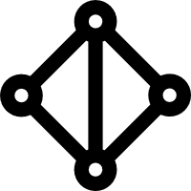
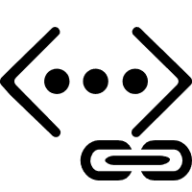
AKS Advanced Networking
1
On-premises infrastructure
Uses Azure subnet for both your pods and cluster VMs
3
Azure VNet A
Enterprise system
Backend services subnet
Allows for connectivity to existing Azure IaaS/VMs in the same VNet
AKS subnet
Azure Express Route
AKS cluster
SQL Server VM
Use ExpressRoute to connect to on-premises infrastructure
Azure SQL PaaS DB
5
2
Use VNet peering to connect to other VNets
Service Endpoint
VNet peering
Connect AKS cluster securely and privately to Azure PaaS using VNet endpoints
Other peered VNets
4

Slide 83
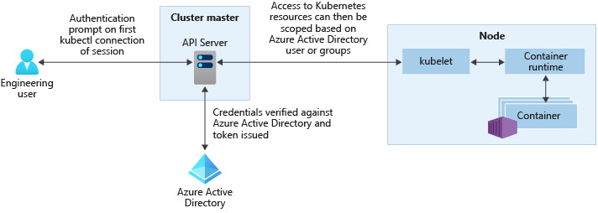
Azure Active Directory
https://docs.microsoft.com/azure/aks/managed-aad
Use Azure Active Directory to authenticate AKS access
Assign roles & permissions in Kubernetes RBAC, based on AAD users & groups
Roles & groups in AAD define who has access to the cluster

Slide 84
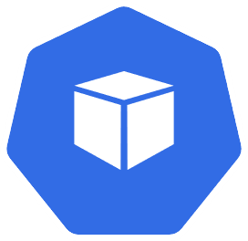

‘HTTP application routing’ Add-On
docs.microsoft.com/azure/aks/http-application-routing
Simplifies Ingress and DNS for external access to HTTP services in cluster
Creates: - NGINX Ingress controller (in cluster) - External DNS helper (in cluster) - aksapp.io DNS Zone (in Azure)
{id}.aksapp.io
AKS
Ingress
External DNS
Pods
--enable-addons http_application_routing
The HTTP application routing add-on is designed to let you quickly create an ingress controller and access your applications. This add-on is not recommended for production use

Slide 85






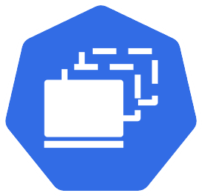

‘Monitoring’ Add-On
docs.microsoft.com/azure/azure-monitor/insights/container-insights-overview
Azure Monitor – Container Insights
Visualization
Visualize overall health and performance from clusters to containers with drill downs and filters
Azure
Alerts
Insights
Provide insights with multi-cluster health roll up view
Container Insights
Log Analytics
Monitor & Analyze
Monitor and analyze Kubernetes and container deployment performance, events, health, and logs
Dashboard
Response
Native alerting with integration to issue managements and ITSM tools
Reports
AKS
Observability
Observe live container logs on container deployment status
--enable-addons monitoring --workspace-resource-id {my-azure-monitor-logs-ws}
Metrics
collector agent

Slide 86

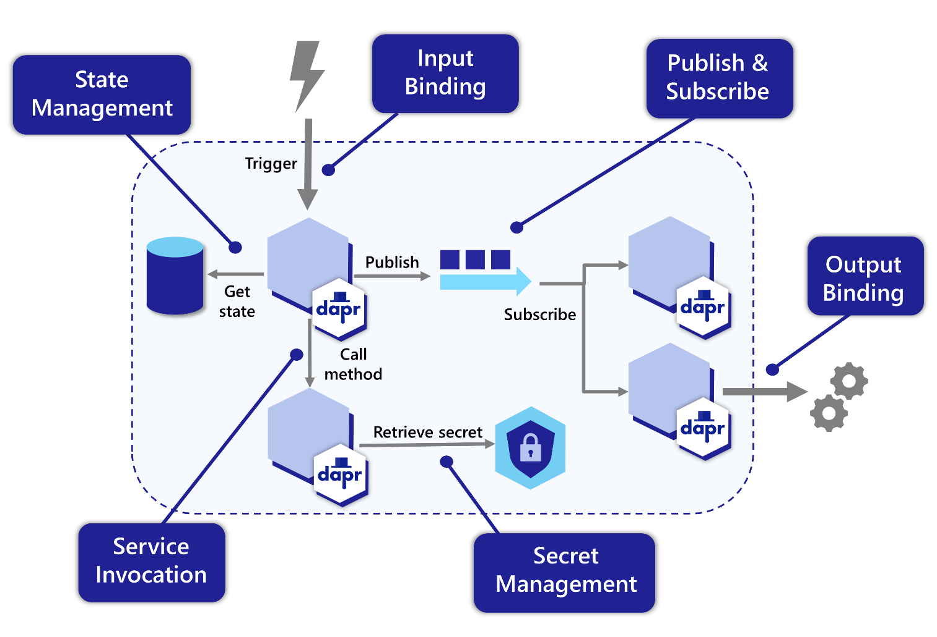
Dapr
APIs for building portable and reliable microservices
dapr.io
Dapr is a portable, event-driven runtime to simplify building microservices
A wide range of APIs and building blocks for common patterns such as pub sub, service invocation and storing state
Use triggers to build event driven applications
Out of the box components & connectors for many 3rd party systems
az k8s-extension create
--cluster-name my-cluster
--extension-type Microsoft.Dapr
https://docs.dapr.io/concepts/building-blocks-concept/

Slide 87
AKS Virtual Nodes
Elastically provision compute capacity in seconds
No infrastructure to manage
Builds on top of Azure Container Instances (ACI)
Uses Virtual Kubelet
Scenarios:
Bursting
CI/CD
“Serverless Kubernetes”
AKS
VM Node
VM Node
https://virtual-kubelet.io/
Pods
Pods
Azure Container Instances (ACI)
Kubernetes control plane
Pods
Virtual node

Slide 88
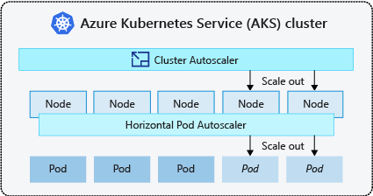


Cluster Auto Scaler
docs.microsoft.com/azure/aks/cluster-autoscaler
Autoscaling with Azure Scale Sets
Enables the standard Kubernetes Cluster Autoscaler (CA)
Leverages VM Scale Sets
Settable per node pool if using multiple pools
--enable-cluster-autoscaler
--min-count 1
--max-count 8
Node Pool

Slide 89
Additional Resources
Kubernetes Learning Path
Kubernetes Docs
Kubernetes Hands On Lab
Kubernetes
Workshop
Katacoda
Courses
Udemy Course
API Reference

Slide 90
THANK YOU

Slide 91
Change Log
1.0 – Initial release
1.1 – Typos and fixes, added final additional resources slide
1.2 – Added AKS section & taints/affinity
1.3 – Extra sections on AKS
1.4 – Minor refresh, ConfigMaps and service mesh
1.5 – Added Operators & CRD, removed Dev Spaces and some minor refreshes
1.6 – Removed Docker references, added GitOps & Dapr, general update

